Slide 1


HR ANALYTICS
EMPLOYEE RETENTION
Mentor : Dipti Sinha
Presented by :
1. Sahira. I. Bagwan
2. Monika Anand 3. Niharika Panda
4. Sairam Bandaru 5. Priya Rajendra Pawar

Slide 2
Introduction
KPI’s
Dashboard
Key TakeAways
Conclusion
Contents

Slide 3
Introduction
Understanding company’s workforce is critical for making informed decisions and improving overall performance.
Significance:
In today's rapidly evolving business landscape, understanding company’s workforce is paramount.
Employee data analysis empowers organizations to make informed decisions and enhance overall performance.
This presentation delves into valuable insights extracted from a company’s employee data to drive strategic actions and improvements.

Slide 4
KPI’s
1. Average Attrition rate for all Departments
2. Average Hourly rate of Male Research Scientist
3. Attrition rate Vs Monthly income stats
4. Average working years for each Department
5. Job Role Vs Work life balance
6. Attrition rate Vs Year since last promotion relation

Slide 5
Average Attrition rate for all Departments
Inference
The average attrition rate across all departments is 50%.
The departments with the highest attrition rates are Research & Development, Software, and Human Resources, each having an attrition rate of around 51%.
Hardware and Sales departments have slightly lower attrition rates at 49% and 50% respectively.
50.21%
Insight:
From this data, while the organization experiences a 50% attrition rate, there are distinct variations among departments.
The higher attrition rates in Research & Development, Software, and Human Resources departments suggest that targeted efforts may be needed to address underlying issues and improve employee retention in these areas.
Total Attrition Rate

Slide 6
Average Hourly rate of Male Research Scientist
Inference
The hourly rate does not significantly vary across the various job roles.
The average hourly rate of male research scientist is 114 hours which is less as compared to other job roles like laboratory technician, HR, manufacturing director and health care representative.
Insight :
Despite less working hours the research and development department has high attrition rate.
The main factor responsible for this might be lack of innovation and purpose or inadequate compensation.

Slide 7
Attrition rate Vs Monthly income stats
Inference :
Hardware Department has the lowest attrition rate of 49.44%, with an average monthly income of Rs. 26,028.
On the other hand, the Research and Development Department has the highest attrition rate of 51.21%, with an average monthly income of Rs. 25,796.
Insight :
If the employee benefits plus the salary are not according to the workload on a employee, driving them to organizations that do offer generous salaries and benefits.
So to reduce attrition in R&D department, a salary hike should be granted.
Pay and purpose of a company should align.

Slide 8
Average working years for each Department
Inference :
Average working years is approximately 20 years for all departments
But the employees from Research and Development department are leaving the company more as compared to other departments.
Second and third in line are the Sales and Software department respectively.
Insight :
One of the reasons might be inefficient management, inflexible work environment or a toxic workplace.
HR should come out with a sensible employee feedback and most importantly reinvent policies and regulations with respect to the feedback

Slide 9
Job Role Vs Work life balance
Inference :
The average work life balance is nearly same across all job roles.
Overwork and lack of growth and progression are the primary factors promoting attrition within an organization.
Insight :
Employees experiencing a burnout tend to leave the company.
Focusing on well-being and mental health. This aspect has become crucial for employee satisfaction since the pandemic. Provide support to employees during personal emergencies and give them the flexibility to focus on their mental health.

Slide 10
Attrition rate Vs Year since last promotion relation
Insight :
The average years since the last promotion vary slightly across different job roles, ranging from 5 to 6 years approximately.
Interestingly, job roles with lower years since the last promotion tend to have slightly higher attrition rates.
Inference :
R&D department with the attrition rate of 51.2% have 5.88 years in the same position while HR department with the second lowest attrition rate of 49.86% have 5.95 years in the same position.

Slide 11
DASHBOARD

Slide 12
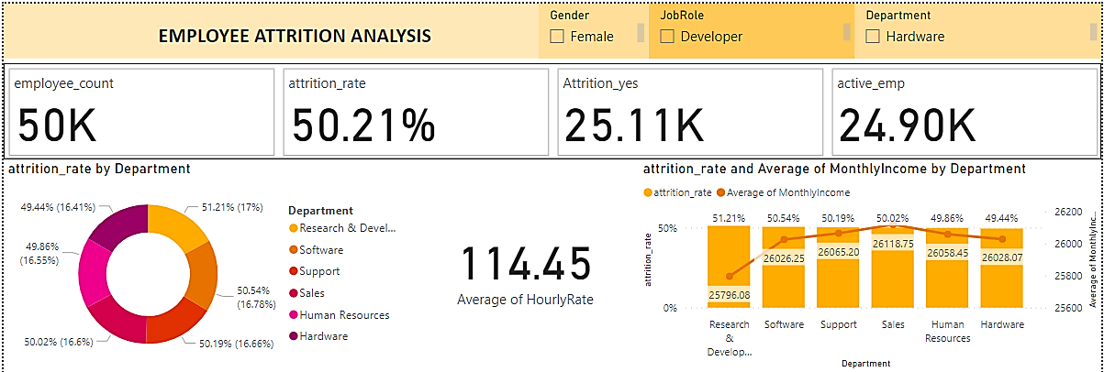
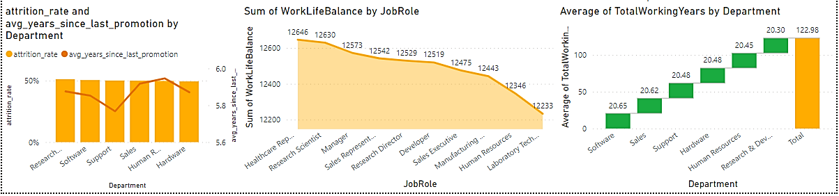

Slide 13
KEY TAKEAWAYS
Possible Employee attrition reasons:
Overwork
Inadequate compensation
Lack of career growth opportunities
Lack of innovation or purpose
Inefficient management
Inflexible work environment
No matter what the reason, employee attrition is an expensive business problem and filling vacant positions costs significant time and money. Effective recruitment includes hiring, onboarding, and training – all of which translate to increased time cost and financial investment.
When employees depart, they take away more than just their skills. They leave behind gaps in client relationships, unique perspectives and experiences, and personal and professional networks.
Therefore, it makes sense for organizations to calculate the employee attrition rate and look for ways to save costs, time, and effort.

Slide 14
CONCLUSION
Conduct stay interviews:
Instead of exit interviews, conduct stay interviews with employees to gather feedback about the job.
Improve employee engagement:
Implement initiatives to improve employee engagement, such as regular feedback, recognition and rewards programs, and opportunities for career growth.
Address workload issues:
Ensure employees have manageable workloads by regularly monitoring and adjusting workloads to prevent burnout and overwhelm.
Create a positive work environment:
Foster a positive work environment by promoting a culture of respect, inclusivity, and teamwork. Encourage open communication and collaboration among employees.
Address pay and compensation issues:
Ensure that employees receive fair pay and compensation for their work and to find out what motivates an employee to continue to work in an organization.
Monitor and Analyze:
Continuously monitor and analyze employee data for ongoing insights.

Slide 15
THANKYOU

